Slide 1
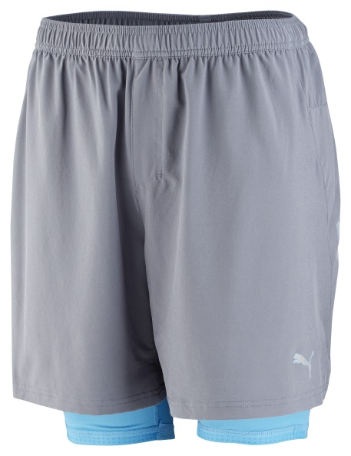
PR PWRCOOL 7” 2-IN1-SHORT
The PWRCOOL 7”’ 2-in-1 shorts feature a compression tight with an inner PWRCOOL print which is activated by moisture to cool the body down and reduce temperatures during a workout.
The laminated, waterproof pocket linings ensure personal belongings stay dry while the tunneled and elasticated waistband with draw cord increases comfort.
The backside features laser-cut holes to improve air circulation and the reflective logos enhance visibility in low light conditions.
Stay cool to maximize energy.
Style Number: 512991 01
Materials: 86% Polyester 14% Elastane
PUMA is one of the world’s leading Sports Brands, designing, developing, selling and marketing footwear, apparel and accessories. For over 65 years, PUMA has established a history of making fast product designs for the fastest athletes on the planet. PUMA offers performance and sport-inspired lifestyle products in categories such as Football, Running, Training and Fitness, Golf, and Motorsports. It engages in exciting collaborations with renowned design brands such as Alexander McQueen and Mihara Yasuhiro to bring innovative and fast designs to the sports world. The PUMA Group owns the brands PUMA, Cobra Golf, Tretorn, Dobotex and Brandon. The company distributes its products in more than 120 countries, employs more than 10,000 people worldwide, and is headquartered in Herzogenaurach/Germany. For more information, please visit http://www.puma.com

