Slide 1
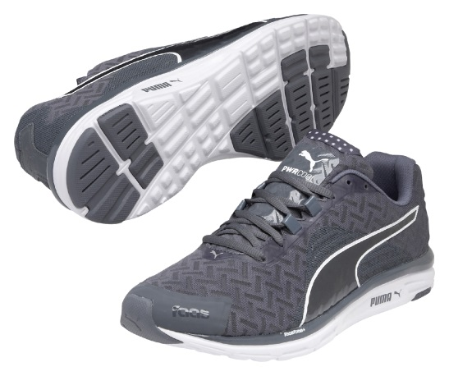
FAAS 500 v4 PWRCOOL
The Faas 500 v4 PWRCOOL is equipped with a thermo-regulating material to combat hot conditions and keep the body cool during a run.
An upgraded midsole material of FaasFoam+ combined with a full EverTrack+ outsole gives a superior, cushioned ride. The upper combines the new EVERFIT 2.0 system with Weave Mesh technology, setting a new precedent with the Faas philosophy of lightweight support. The 4mm HTD encourages a more natural and efficient ride.
Built for the neutral runner, the Faas 500 v4 PWRCOOL provides a cool, responsive and lightweight ride during your run. Finally, the open Air Mesh and Comfor Temp tongue lining optimizes breathability for ultimate foot comfort and body temperature regulation.
Style Number: 187770 03
PUMA is one of the world’s leading Sports Brands, designing, developing, selling and marketing footwear, apparel and accessories. For over 65 years, PUMA has established a history of making fast product designs for the fastest athletes on the planet. PUMA offers performance and sport-inspired lifestyle products in categories such as Football, Running, Training and Fitness, Golf, and Motorsports. It engages in exciting collaborations with renowned design brands such as Alexander McQueen and Mihara Yasuhiro to bring innovative and fast designs to the sports world. The PUMA Group owns the brands PUMA, Cobra Golf, Tretorn, Dobotex and Brandon. The company distributes its products in more than 120 countries, employs more than 10,000 people worldwide, and is headquartered in Herzogenaurach/Germany. For more information, please visit http://www.puma.com

