Slide 1
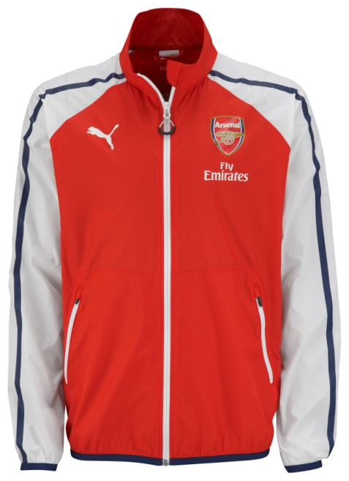
Embargo 22.00 GMT/23.00 UK TIME 10 July 2014
AFC Anthem Jacket
Arsenal moves forward in style, pursues innovation, yet holds fast to traditions on the pitch, in the stands, and beyond. This Anthem Jacket follows suit. A modern take on the classic PUMA T7 Track Jacket, it features a lightweight transparent material with printed T7 stripes.
Style Number: 746380
100% Polyester Ripstop
Regular fit
Pigment print Club Badge
Concordia pigment print
Sponsor logo pigment print
PUMA Cat pigment print
PUMA is one of the world’s leading Sports Brands, designing, developing, selling and marketing footwear, apparel and accessories. For over 65 years, PUMA has established a history of making fast product designs for the fastest athletes on the planet. PUMA offers performance and sport-inspired lifestyle products in categories such as Football, Running, Training and Fitness, Golf, and Motorsports. It engages in exciting collaborations with renowned design brands such as Alexander McQueen and Mihara Yasuhiro to bring innovative and fast designs to the sports world. The PUMA Group owns the brands PUMA, Cobra Golf, Tretorn, Dobotex and Brandon. The company distributes its products in more than 120 countries, employs more than 10,000 people worldwide, and is headquartered in Herzogenaurach/Germany. For more information, please visit http://www.puma.com

