Slide 1
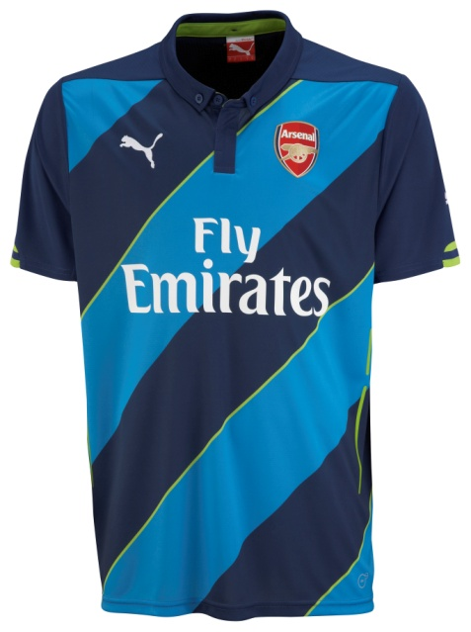
Embargo 22.00 GMT/23.00 UK TIME 10 July 2014
AFC Cup Replica Shirt
The 2014/15 Arsenal FC Cup Replica shirt represents ‘Future’, one third of the Future, Forever, Victorious values identified by PUMA as core to the club and the design inspiration behind the Home, Away and Cup kits. Arsenal has always been driven by innovation and progression, this is symbolised in the blue and lime green shirt that will be worn by the Arsenal team away from home in all cup competitions. The Cup shirt combines diagonal blue stripes with a twist of lime green on the body panels and the sleeve cuff tips, bringing a youthful and fresh look to the shirt. The Cup shirt has a tailored button down collar and placket and heat transfer tapes running down the body that accentuate the torso. Breathable underarm mesh inserts and PUMA dryCELL moisture management technology that draws sweat away from the skin will keep the body dry.
Style Number: 746452
100% Polyester
Regular fit
PUMA dryCELL wicks moisture management technology
Authentic Licensed Product heat transfer
Woven PU Club Badge
Concordia heat transfer
Embroidered PUMA Cat
PUMA is one of the world’s leading Sports Brands, designing, developing, selling and marketing footwear, apparel and accessories. For over 65 years, PUMA has established a history of making fast product designs for the fastest athletes on the planet. PUMA offers performance and sport-inspired lifestyle products in categories such as Football, Running, Training and Fitness, Golf, and Motorsports. It engages in exciting collaborations with renowned design brands such as Alexander McQueen and Mihara Yasuhiro to bring innovative and fast designs to the sports world. The PUMA Group owns the brands PUMA, Cobra Golf, Tretorn, Dobotex and Brandon. The company distributes its products in more than 120 countries, employs more than 10,000 people worldwide, and is headquartered in Herzogenaurach/Germany. For more information, please visit http://www.puma.com

