Slide 1
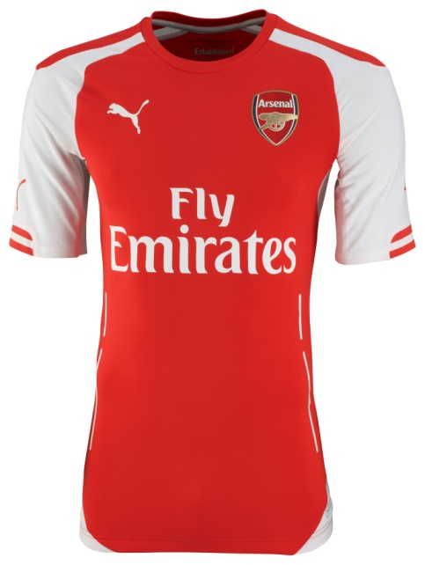
Embargo 22.00 GMT/23.00 UK TIME 10 July 2014
AFC Home Shirt ACTV Authentic
The 2014/15 Arsenal FC Home Replica shirt stays true to the traditional Arsenal colours that first appeared in 1933. It represents ‘Forever’, one third of the Future, Forever, Victorious values identified by PUMA as core to the club and the design inspiration behind the Home, Away and Cup kits, with ‘Forever’ symbolising the importance of community and belonging to both the club and its fans. The crew neck Home shirt has a classic red body with heat transfer tapes running down the body that accentuate the torso. It has iconic white contrast sleeves that feature tipping on the cuffs, a design detail also seen on the Away and Cup shirts. Breathable underarm mesh inserts and PUMA powerCELL moisture management technology will help keep the body dry. The slim fit shirt features PUMA’s new football apparel innovation PWR ACTV, a technology that combines athletic taping and compression within the apparel to help players have a competitive advantage. The ACTV tape is strategically placed within the garment to provide micro-massages on the skin, working with the human body to help maximise performance and provide players with a faster, more effective energy supply to the active muscles.
The Home Shirt ACTV Authentic is identical to the shirt to be worn by the Arsenal team and packaged in a special edition tablet case. A replica version of the Home shirt is also available for purchase giving fans a purchasing choice depending on their budget and preference.
Style Number: 746445
Material: 89% Polyester/ 11% Lycra
PUMA powerCELL technology
Slim fit
Heat Transfer Sponsor Logo
Woven PU Club Badge
Concordia heat transfer
Heat Transfer PUMA Cat
PUMA is one of the world’s leading Sports Brands, designing, developing, selling and marketing footwear, apparel and accessories. For over 65 years, PUMA has established a history of making fast product designs for the fastest athletes on the planet. PUMA offers performance and sport-inspired lifestyle products in categories such as Football, Running, Training and Fitness, Golf, and Motorsports. It engages in exciting collaborations with renowned design brands such as Alexander McQueen and Mihara Yasuhiro to bring innovative and fast designs to the sports world. The PUMA Group owns the brands PUMA, Cobra Golf, Tretorn, Dobotex and Brandon. The company distributes its products in more than 120 countries, employs more than 10,000 people worldwide, and is headquartered in Herzogenaurach/Germany. For more information, please visit http://www.puma.com

