Slide 1
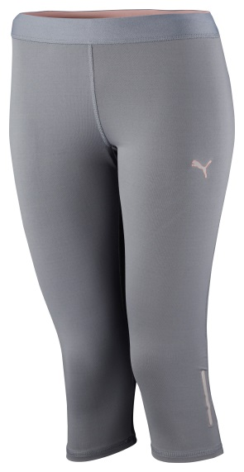
PR PWRCOOL ¾ TIGHT
The PWRCOOL ¾ tight is designed to keep the body cool during a hot work out.
These tights are designed with inherent moisture management and feature an inner PWRCOOL print: strategically placed adaptive materials help keep cool and maintain an optimum body temperature while continuing the pace of the exercise.
The articulated knees and flatlock stitching work together to create optimum comfort and increased freedom of movement. The reflective logos help with visibility in low light conditions.
PWRCOOL combats warm conditions to help the body stay cool, so all the energy put into a workout can be used towards becoming stronger and faster.
Style Number: 512990 02
Materials: 89% Polyester 11% elastane (spandex)
PUMA is one of the world’s leading Sports Brands, designing, developing, selling and marketing footwear, apparel and accessories. For over 65 years, PUMA has established a history of making fast product designs for the fastest athletes on the planet. PUMA offers performance and sport-inspired lifestyle products in categories such as Football, Running, Training and Fitness, Golf, and Motorsports. It engages in exciting collaborations with renowned design brands such as Alexander McQueen and Mihara Yasuhiro to bring innovative and fast designs to the sports world. The PUMA Group owns the brands PUMA, Cobra Golf, Tretorn, Dobotex and Brandon. The company distributes its products in more than 120 countries, employs more than 10,000 people worldwide, and is headquartered in Herzogenaurach/Germany. For more information, please visit http://www.puma.com

