Slide 1
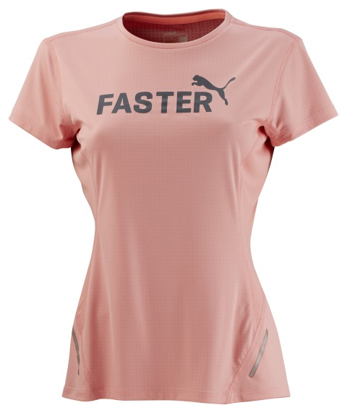
PR PWRCOOL GRAPHIC S/S TEE WN
The PWRCOOL Graphic S/S Tee is made of PWRCOOL technology and designed with flatlock stitching for increased comfort with movement.
The strategically placed adaptive materials help to cool down the body and maintain an optimum temperature. PWRCOOL technology combats warm conditions to keep the body cool. So all the energy put into a workout is used towards becoming stronger and faster.
The graphic tee also features Bluesign® Approved Fabric and is produced using resource efficient processes that focus on sustainable product development and continuous improvement for ecological efficiency.
Style Number: 512841 03
Materials: 100% Polyester
PUMA is one of the world’s leading Sports Brands, designing, developing, selling and marketing footwear, apparel and accessories. For over 65 years, PUMA has established a history of making fast product designs for the fastest athletes on the planet. PUMA offers performance and sport-inspired lifestyle products in categories such as Football, Running, Training and Fitness, Golf, and Motorsports. It engages in exciting collaborations with renowned design brands such as Alexander McQueen and Mihara Yasuhiro to bring innovative and fast designs to the sports world. The PUMA Group owns the brands PUMA, Cobra Golf, Tretorn, Dobotex and Brandon. The company distributes its products in more than 120 countries, employs more than 10,000 people worldwide, and is headquartered in Herzogenaurach/Germany. For more information, please visit http://www.puma.com

