Slide 1
Brand Transparency
Best practices in AV Communications
Matt Thomson, MD TheNewsMarket, part of DMA Media
@ThomsonMAF
Notes:
I’m Matt Thomson, MD at TheNewsMarket, a global content communications agency. We are part of DMA Media Group, Europe’s largest independent news services company.
We run one of the largest audiovisual content hub for brands and journalists called thenewsmarket.com, making over 20TB of multimedia content available for preview and download every year.
I will be talking about how in a climate of fake news, it is more important than ever for brands to be transparent and share their story.
As we all know, brands are going through heavy times today and no one is immune to fake news.
At the beginning, the majority of the coverage around fake news has focused on its political influence (see for example the US elections), but this has begun to seep over into the corporate world.
For example, in the lead-up to the US Presidential election, Trump supporters called for a boycott on Pepsi products over fabricated statements claiming CEO Indra Nooyi told Trump fans to "take their business elsewhere." She never actually said that.
This week, HSBC, Lloyds, Royal Bank of Scotland have become the latest brands to pull advertising from Google after it was revealed they had been inadvertently funding hate speech videos on YouTube. Brands and their media agencies are demanding higher brand safety standards and more control over where their ads appear across YouTube and Google.
We can see why, in this climate, brand transparency – via telling their true story, is becoming a priority for many brands. And no medium is more trustworthy and engaging than video. UEFA, PwC and LEGO are three brands that have embraced video to huge success and helped manage their brands and facilitate trust.

Slide 2
Brand transparency – 3 DRIVERS
Consumer/
Public
Internet
Social Media
Fake
Information
Notes:
We can identify 3 main drivers that has led to increased transparency from brands:
1) First, consumers (and the general public) want to know everything about a product and know more about the brand. Brands are affected by a new generation of consumers who have a greater expectation for transparency and are increasingly concerned about a company’s values – who they are, what they stand for, and how they operate.
2) Second, the internet and social media have made it hard for brands to hide. Information is more accessible than ever and travel faster than ever.
3) This leads to my third point. Fake information or fake news. If your brand isn’t transparent, consumer will hunt for information elsewhere. And this is where they can be exposed to fake news. According to a recent survey by the Chartered Institute of Marketing, 25% of consumers have seen fake news online.
By becoming more transparent, brands will be able to retain more control over their message and what they really stand for.
How can a brand become more transparent?

Slide 3
Brand transparency – HOW?
No to
‘No Comment’
Provide
Content
Communicate
Notes:
1) Communicate. It is crucial to communicate positive corporate values. What might have started out as internal, corporate initiatives to be more sustainable or authentic are now full-blown media & marketing campaigns.
2) No to ‘No Comment’. Address rumours or being the target of a fake news story. It goes back to my first point, communicate. Issue a statement, use your official channels and work with trusted media and influencers to spread the truth. In short, provide content.
3) Provide content. Providing your own brand content, available on your official channels, will help tell your true story and curate all ‘official’ content. Brands have to become their own publishers.
Providing content means using the right channels to reach the targeted audiences.

Slide 4
Brands are becoming publishers
PAID
EARNED
SHARED
OWNED
Notes:
As shown in this graphic, a successful content distribution strategy would include a mix of:
1) Paid Media – this is essentially paid advertising
2) Earned Media – this is editorially driven content aim to gain the interest of the media without having to pay for it.
3) Shared Media – this is content amplified by your community through social media
4) Owned Media – this is the content that you create (blog posts, videos, white papers, etc.), publish and control through your own dedicated channels such as your websites and blogs.
More concretely, what are the most effective tools that brands can use to help them become their own publishers?

Slide 5
Brand are becoming publishers
ONLINE
NEWSROOM
NEWS
DISTRIBUTION
VIDEO
SOCIAL
MEDIA
LIVE
STREAMING
Notes:
Video. Content is becoming a competitive necessity – with so many options to choose from.
Of all the types of content a brand can produce, video is seeing the fastest growth. By 2020, video will account for 82% of all consumer internet traffic (up from 70% in 2015), according to Cisco.
Axonn Research found 7 in 10 people view brands in a more positive light after watching interesting video content from them. Video builds an emotional connection by bringing your brand to life.
Brand online newsroom. As content creators, brands need to be able to publish content on their own terms, and more importantly, have an effective way to aggregate their best stories and multimedia assets in one accessible and intuitive platform.
News distribution. Having great relevant content is important. But being able to distribute it efficiently is crucial so your story can be heard. There are many ways a brand can distribute content, including media relations/own pitching, newswires, or a content distribution hub such as thenewsmarket.com – where news is distributed to 36,000+ news organisations in 190 countries.
Social media. With the level of engagement on social media increasing, and new social channels coming to the forefront, consumers are being immersed into this digital world more than ever before. Which is why it's crucial for brands to ensure they communicate transparently and honestly online.
Live streaming. In recent years, video has taken a whole new dimension with the likes of Periscope and Facebook Live – adding the ability to stream live video very easily. Audiences are engaging with live video more than ever, an opportunity brands are increasingly taking notice of and embracing – specifically on social media.
More professionally, with Satellite Media Tours, brands are offering news outlets the possibility to interview their C-level executives live.
Let’s see some examples of organisations who are successfully using multimedia and audio-visual tools to manage their brand, be more transparent and facilitate trust.

Slide 6
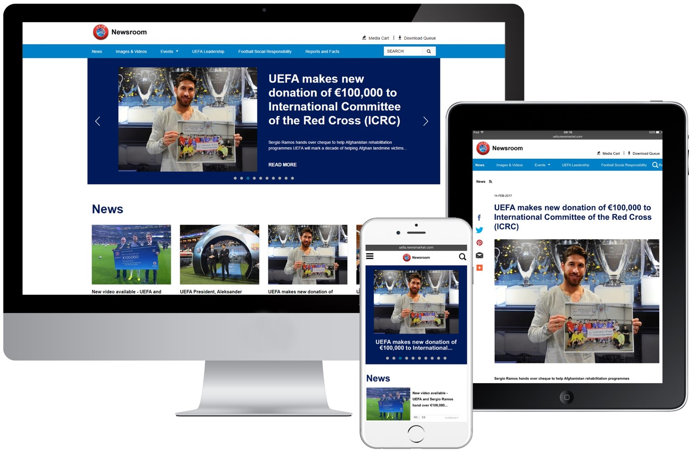
UEFA
OPEN NEWSROOM
TO ALL
CONTENT
EASILY ACCESSIBLE
ACROSS
ALL CHANNELS
Notes:
UEFA has the aim to demystify the organisation, make it more human and talk about social responsibility.
They are doing it by opening their online newsroom and content to all, without restrictions. They have made content and especially video easily accessible across all multiple channels.
Since adopting this strategy, we have seen an increase in media engagement and media requests for UEFA content about CSR and other grassroots initiatives.

Slide 7
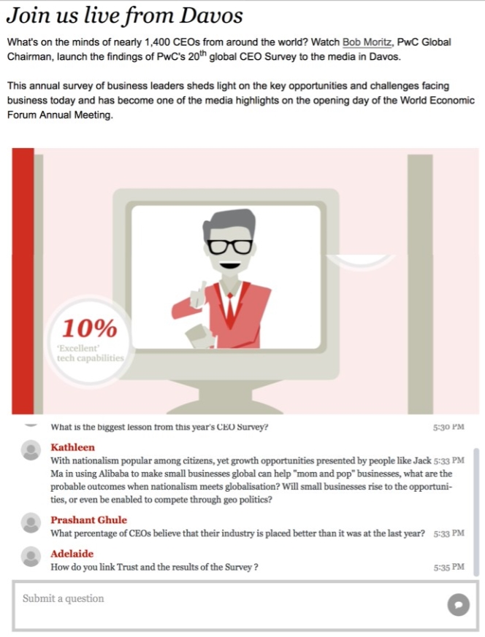
PwC
OPEN LIVE STREAM
OPEN TO PUBLIC
OPEN Q&A
Notes:
Having worked with PwC for many years, we have helped the organisation become content publishers and embrace fully open audio-visual tools.
Every year, PwC releases their Global CEO Survey at the World Economic Forum in Davos.
They communicate through video, infographics, open live stream/webcast, as well as an open Q&A – with both media onsite and attending remotely.
This year, the Q&A was even open to the general public.

Slide 8
LEGO GROUP
LEADERS NOT AFRAID
TO BE TRANSPARENT
LIVE INTERVIEWS
CORPORATE
SUSTAINABILITY REPORT
ADDRESS ISSUES OPENLY
Greenpeace / Shell
Ai WeiWei
Sustainable Materials
Notes:
LEGO has been hit by its fair share of controversy and bad news stories such as a very public run-in with Greenpeace over the toy company’s commercial association with Shell, or its public spat with the Chinese activist artist Ai WeiWei after refusing to sell him building blocks for a (political) installation?
In both cases the Danish toymaker was brave and smart enough to be open about the issues and address them publically. Here, changing its mind.
We have been working with the LEGO Group since 2009.
Their leaders are bit afraid to be transparent. CEO, CFO and CMO often conduct live interviews on TV – discussing topics as varied as financial results, new markets, sustainability, workforce and Brexit.
They address issues openly and discuss what they are doing about them. The environment, sustainability and petroleum-based materials have always been subjects of controversy for the brand.
I would like to show you a video of live interviews we have scheduled for LEGO’s CEO, Jorgen Knudstorp, announcing the brand’s 1 billion Danish Kroners investment to boost search for sustainable materials.

Slide 9
Notes:
PLAY VIDEO
This year, LEGO has been named the ‘most powerful’ brand in consulting firm Brand Finance’s annual survey – with consumers naming LEGO as the brand they prefer and intend to purchase.

Slide 10
Conclusion
IMPACT OF
BRAND TRANSPARENCY
"People are going to want, and be able, to find out about the citizenship of a brand, whether it is doing the right things socially, economically and environmentally."
– Mike Clasper, former VP P&G Europe, and former CEO LHR Airports
CONTENT TO
FACILITATE TRUST
MULTITUDE
OF CHANNELS
Notes:
As rightly said by Mike Clasper, former VP P&G Europe, and former CEO LHR Airports:
"People are going to want, and be able, to find out about the citizenship of a brand, whether it is doing the right things socially, economically and environmentally."
So as a brand, be transparent.
1) We have seen the impact brand transparency can have. In the long run, brand transparency generates brand loyalty.
In fact, according to the 2016 Label Insight Transparency ROI Study, 56% of consumers surveyed said they would be loyal to a company for life if it provided complete transparency.
When consumers find a brand they feel they can trust, they're likely to stick with that brand for the long-term.
2) We have also seen that content (and video) is key to facilitate trust and creating and publishing your own content help engagement and most importantly allowing your ‘official’ message to be found and heard.
3) Finally, brands have at their disposable a variety of tools and channels to help be more transparent and create meaningful relationships with their key audiences and influencers.

Slide 11
Smart Brand Share Stories.

